Slide 1
Week 3 Agenda
Different metadata standards
Lab session – metadata interfaces

Slide 2
What’s wrong with Dublin Core?
Few options for dealing with ambiguity
Doesn’t cover all metadata uses
Users don’t know what the terms mean

Slide 3
<contributor>:
What is a contributor?
How can I distinguish among contributors?
Why should I use this when <creator> exists?

Slide 4
<relation>:
Relation to what?
How can I tell the difference if there’s more than one?

Slide 5
<coverage>:
What does this field mean?

Slide 6
<source>:
What does this field mean?

Slide 7
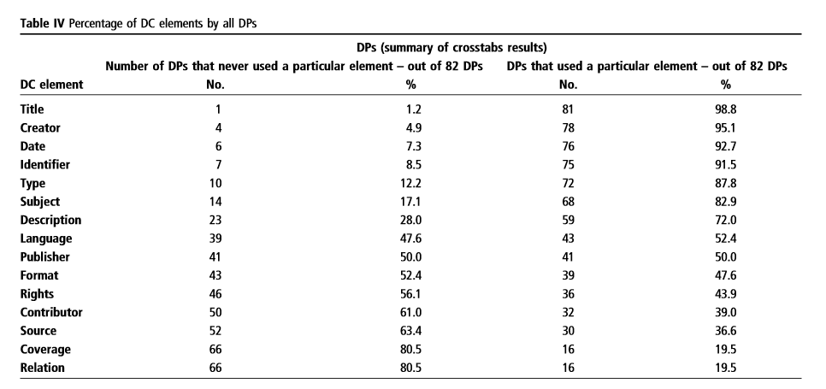
Ward, Jewel. “Unqualified Dublin Core Usage in OAI-PMH Providers.” OCLC Systems and Services, 20(1), pp. 40-47. http://dx.doi.org/10.1108/10650750410527322
Notes:
http://dx.doi.org/10.1108/10650750410527322

Slide 8
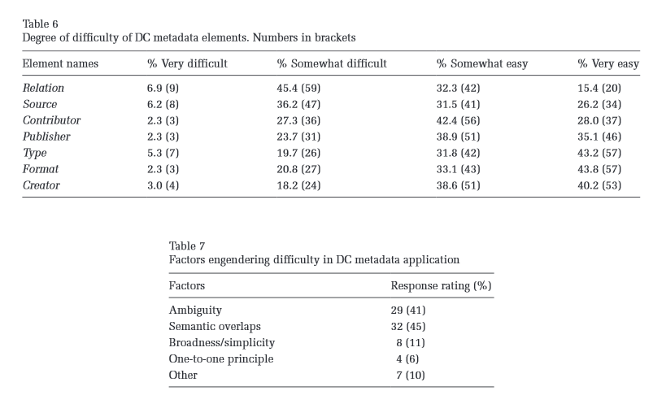
Park, Jung-ran and Childress, Eric. “Dublin Core Metadata Semantics: an analysis of the perspectives of information professionals.” Journal of Information Science, 35(6), pp. 727-739. http://dx.doi.org/10.1177/0165551509337871
Notes:
http://dx.doi.org/10.1177/0165551509337871

Slide 9
Ambiguity: what does this field mean? How is it applied? Why are they applying it differently from us?
Semantic overlaps: terms with similar meanings (e.g. Type and Format, Creator/Contributor/Publisher)
Simplicity
The 1:1 Principle: not really followed, not clear that it makes sense

Slide 10
Other standards
MARC
MODS
VRA Core
EAD (and its younger sibling, EAC-CPF)

Slide 11
Standards that go well with them
PREMIS (preservation metadata)
METS (structural metadata)

Slide 12
The newest standards
Schema.org
BIBFRAME
Linked data and RDF

Slide 13
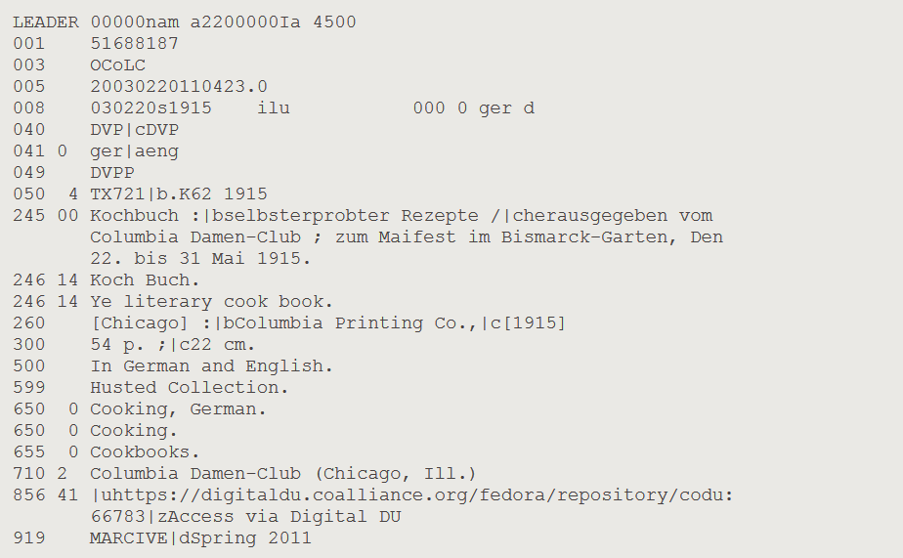
MARC
Notes:
http://www.loc.gov/marc
http://oclc.org/bibformats/en.html

Slide 14
MARC
Not very well-supported by digital repository software
But it’s where most of its metadata starts
And everyone uses it

Slide 15
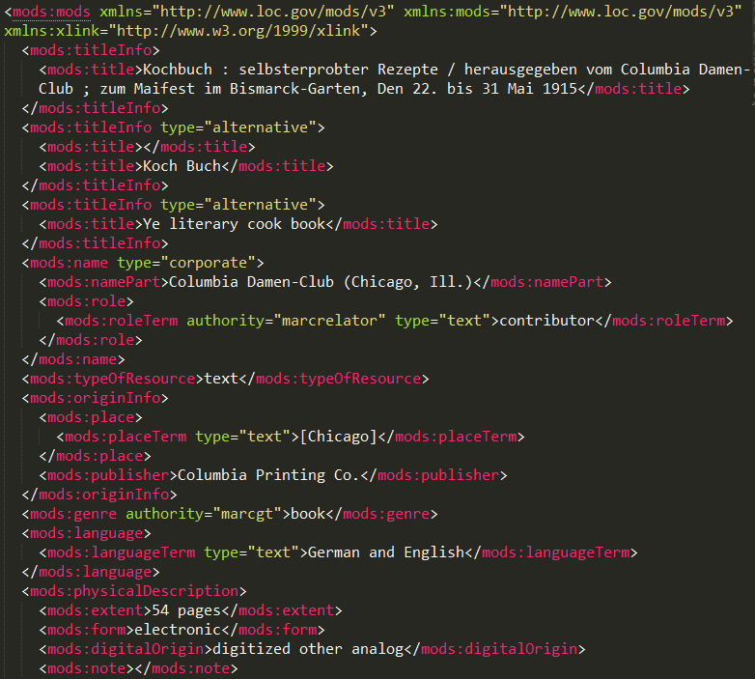
MODS
(not actually a complete record)
Notes:
http://loc.gov/standards/mods

Slide 16
MODS
Roughly equivalent to MARC
Used in lots of systems (Fedora, Islandora, etc.)
Mappings to/from DC are… imprecise
Notes:
http://www.loc.gov/standards/mods/mods-dcsimple.html

Slide 17
VRA Core
From the visual resources community
Distinguishes between Collection, Work, and Image
Notes:
http://core.vraweb.org

Slide 18
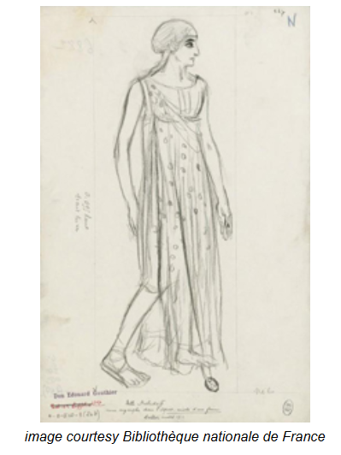
VRA Core
Notes:
http://core.vraweb.org/examples/html/example045_full.html

Slide 19
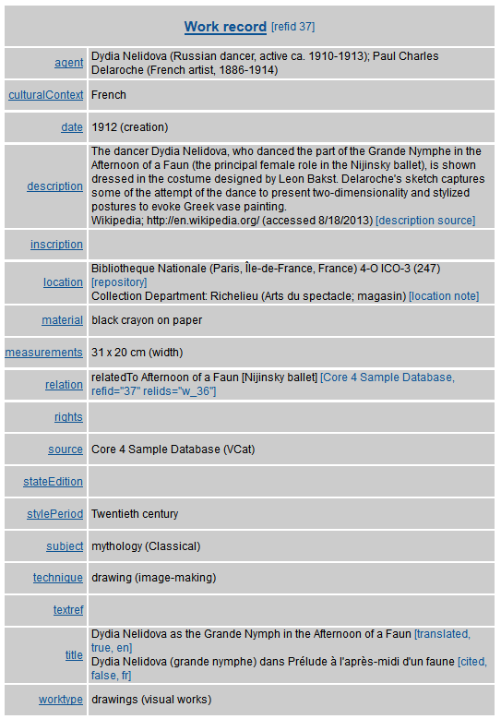
VRA Core
Notes:
http://core.vraweb.org/examples/html/example045_full.html

Slide 20
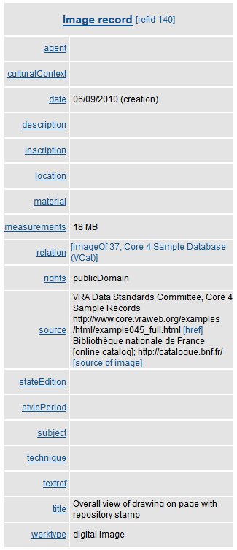
VRA Core
Notes:
http://core.vraweb.org/examples/html/example045_full.html

Slide 21
EAD
For archives
Designed to provide structure to archival finding aids
Not quite as linky (a lot of free text notes)
Notes:
http://loc.gov/ead

Slide 22
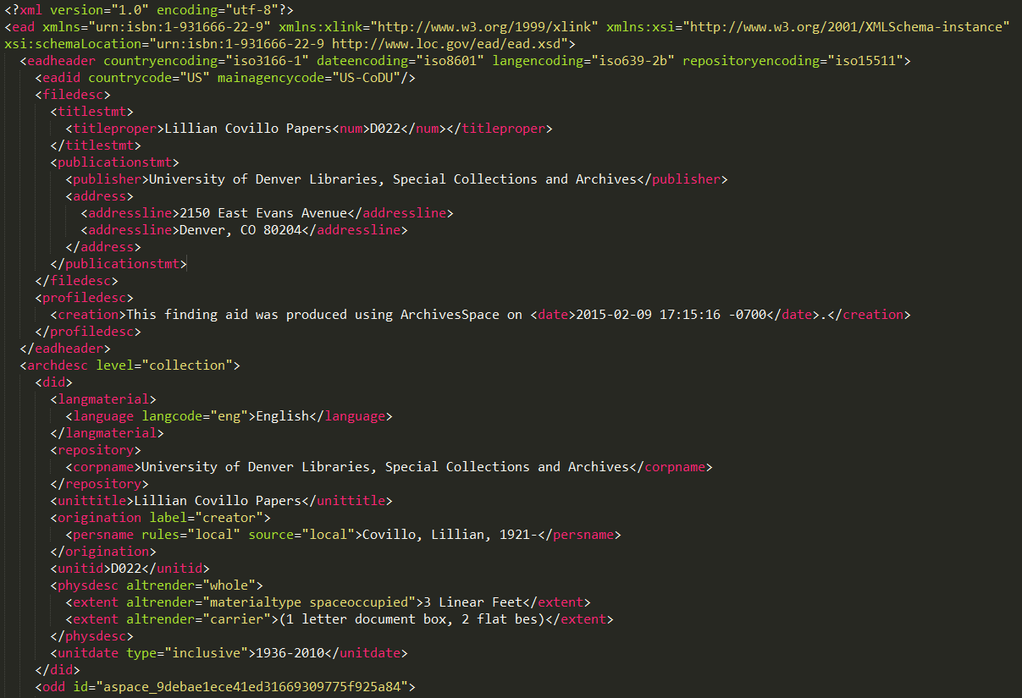
EAD

Slide 23
EAC-CPF
For archival authority data
Information about people, corporate names, families
Meant to help relate named entities to each other
Notes:
http://eac.staatsbibliothek-berlin.de/

Slide 24
PREMIS
Preservation metadata
Events, format registries
Not usually created by humans
Notes:
http://loc.gov/standards/premis

Slide 25
METS
Structural metadata
Documents relationships among files in a digital object (e.g. a multi-page book or scrapbook)
Not usually created by humans
Notes:
http://loc.gov/standards/mets

Slide 26
Some other metadata standards
PBCore (broadcasting, A/V)
FGDC (geographic and geospatial)
EML (ecological and environmental studies)
TEI (text encoding, digital humanities)
Notes:
PBCore: http://pbcore.org
FGDC: http://fgdc.gov/metadata
EML: http://en.wikipedia.org/wiki/Ecological_Metadata_Language
TEI: http://www.tei-c.org/index.xml

Slide 27
Schema.org
Designed by search engines
Allows for structured data about things that can be easily indexed by search engines
Notes:
http://schema.org

Slide 28
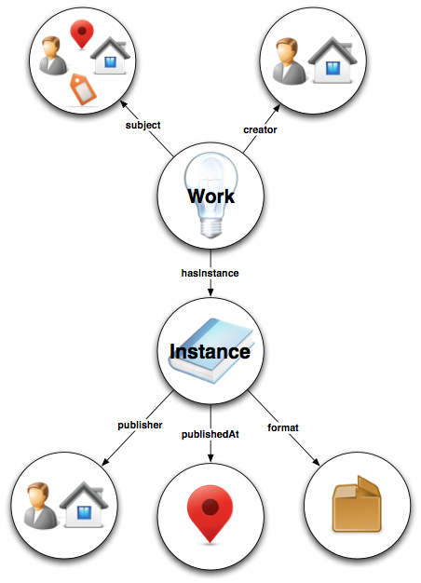
BIBFRAME
Notes:
http://bibframe.org

Slide 29
Linked data and RDF
I’m not going to get into this for real until next week
But here’s how OCLC uses it:

Slide 30
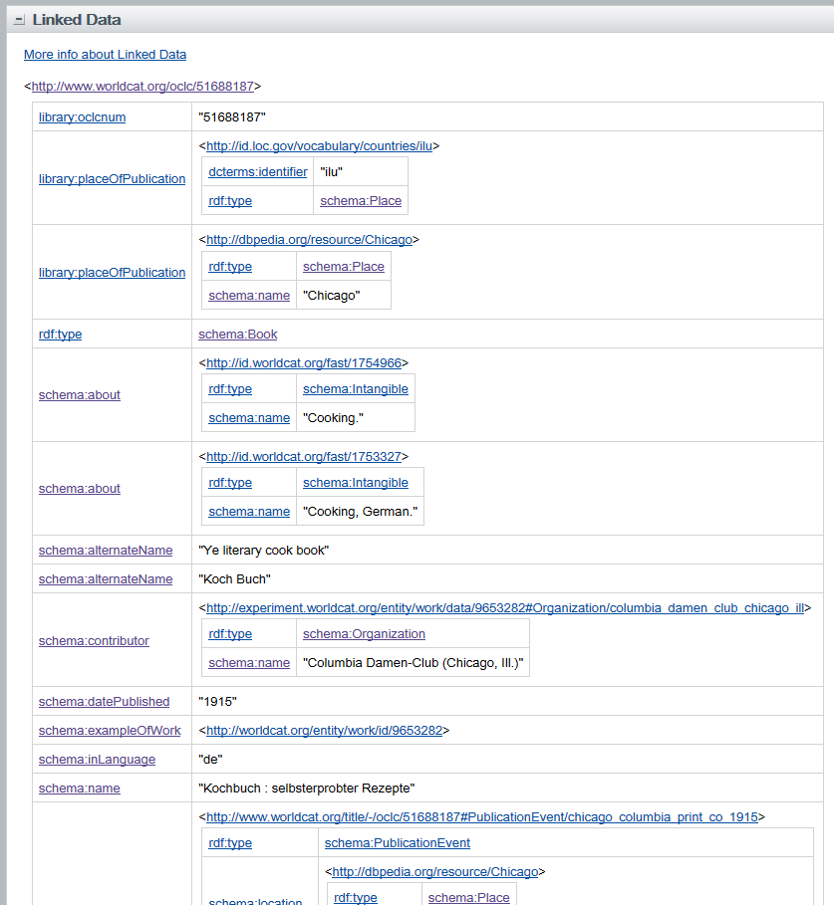
Linked data and RDF
Notes:
http://www.worldcat.org/title/kochbuch-selbsterprobter-rezepte/oclc/51688187
(or any OCLC record, just scroll down to the bottom and expand the “Linked Data” tab)

Slide 31
Lab
Metadata forms and inputs

Slide 32
Lab Report #3
Pick one of the metadata forms we looked at today, or a different one you work with or have seen before
Write up a one-page review of what works and doesn’t work about it for you

Slide 33
Assignment #2
Compare at least two metadata standards in the context of the collection for which you plan to create metadata
Explain why you are selecting one standard or another, or mixing elements from each, based on the content of your collection and the uses you expect
2-3 pages
Due next Tuesday at midnight

